Slide 1
GES DISC Cloud Migration Overview
Lucas Sterzinger, PhD
GES DISC AIRS/Sounder Data Production and Archive

Slide 2
What is “the cloud”?
Amazon Web Services (AWS) provides a suite of storage and compute services.
NASA is moving all data to AWS storage. Some NASA services (such as OPeNDAP, subsetters, etc) are being unified (as opposed to being DAAC-specific) and moved to the cloud.
This includes the Common Metadata Repository (CMR), a database of all NASA Earthdata collection and granule metadata. It can be publicly used for search and discovery of NASA data across all DAACs, and is the backbone of tools like Earthdata Search
GES DISC, like all other DAACs, is working on moving all data from our on-prem archive servers to Earthdata Cloud storage
NASA is providing storage, but not compute
All publicly accessible datasets from GES DISC have been migrated and are now available on Earthdata Cloud*. Service migration is ongoing (will be discussed in a later slide)
* Pending final validation

Slide 3
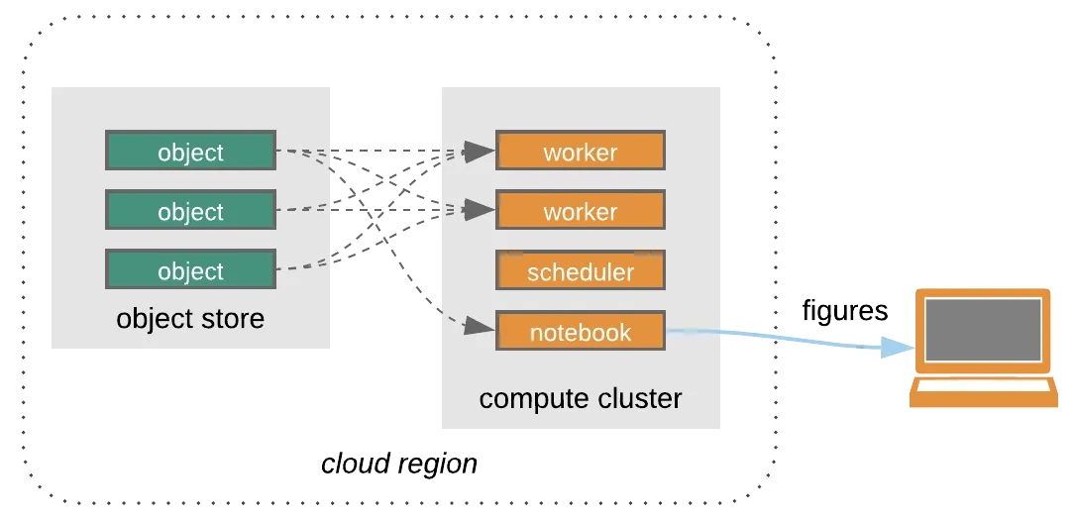
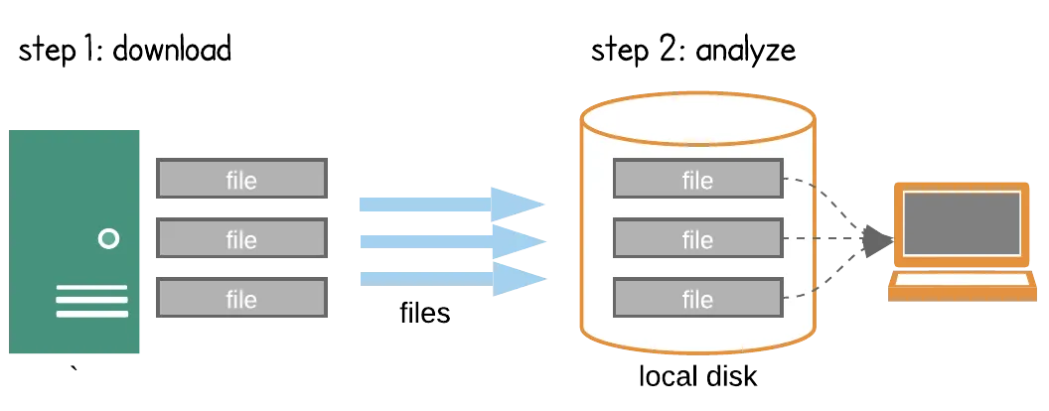
Why is cloud computing beneficial to NASA Earth Science?
Traditional Scientific Computing
Cloud-based Scientific Computing
GES DISC
This workflow will continue to be available to users - the files will be downloaded from the cloud instead of our servers
Image source: Ryan Abernathey

Slide 4
Impact to users
The following points are outlined in more detail on our website (also of note a section specifically for data providers)
Accessing GES DISC data in the cloud remains free of cost to users.
Direct S3 access of GES DISC data is now available.
Direct S3 access is a new option for accessing cloud-hosted data. Direct S3 access is available to users operating within the AWS us-west-2 region.
Users are responsible for their own cloud computing resources if direct S3 access is desired
Accessing cloud data over HTTP or via Cloud-OPeNDAP allows for much higher throughput than our current on-prem options
All public data is available in the cloud via HTTP, migration to Cloud OPeNDAP is ongoing

Slide 5
Impact to Data Providers
Cost Responsibilities: There is no additional cost to the data provider for archiving data in the cloud. Data archive for NASA mission data is funded through Earth Science Data Systems, not the project/mission.
Data Delivery: Current data delivery methods are unimpacted and will be continued to be supported in the short/medium-term. New products have the ability to be delivered directly into the cloud.
Cloud Use Code Samples: If you have code samples (e.g. script, Jupyter Notebook) specific to cloud access and use of your dataset that you would like to share with users, we recommend sharing its location with your GES DISC point of contact so they can include it as a "software" link on the dataset landing page.

Slide 6
GES DISC Cloud Migration Timeline
Data are available in Cloud Storage
This was completed earlier this year. All public datasets have been migrated to the cloud, though some are still waiting for final verification before getting the “available in the cloud” icon on our website
Services are being migrated to DAAC-unified cloud equivalents ← We are here
Services such as data subsetters and file format converters are under active development.
GES DISC staff are busy making sure that each of our collections works with Cloud-OPeNDAP
We will validate data with other services as they become available. This is a very manual process, so please be patient as we work through our 1,700+ public collections
Unification of all DAAC websites to https://earthdata.nasa.gov
GES DISC is slotted for end of year 2026
Eventually, public access to on-prem archive and services will be disabled
No firm guidance on when this will be, but likely not for 2+ years at earliest
Data service validation will need to be done for every collection
SIPS will have access to on-prem data beyond this date. Eventual server decommissioning will happen but is a long way out.

Slide 7
Conclusion
This is all in a state of flux - deadlines can (and will likely) change
Please feel free to reach out with questions or concerns: gsfc-dl-help-disc@mail.nasa.gov

